Slide 1
Internal Infrastructure of municipialities
Hannes PRESSL, Major of Ardagger
Vice President of the Lower Austrian Association of Municipalities
on behalf of the austrian Association of Municipalities

Slide 2
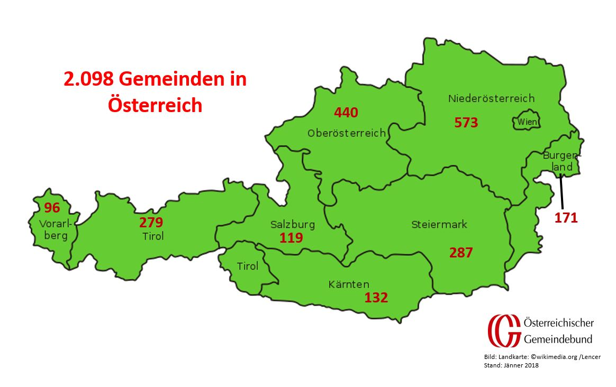
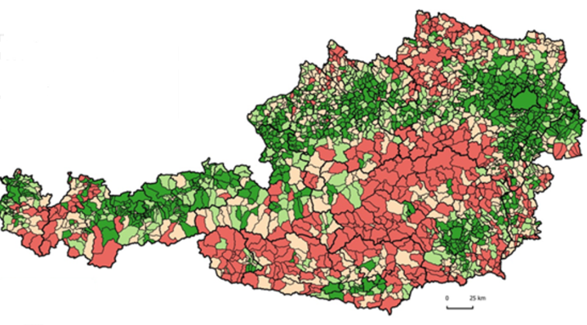
Municipalities in Austria
Whole Country Size: 87.000km2
2098 municipalities in Austria

Slide 3
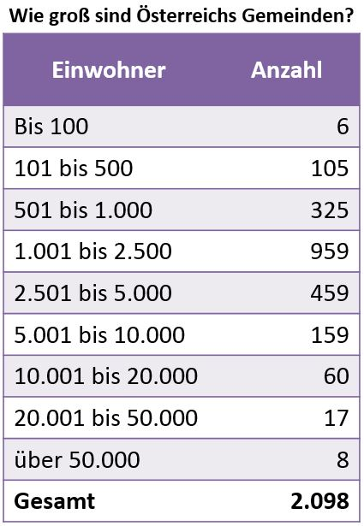
Size of Austrian municipalities
88% communities have
less than 5.000 inhabitants
52% of Austrians live
in communities with
less than 10.000 inhabitants

Slide 4
Average size of european municipalities: about 5000 inhabitants

Slide 5
Municipalities in Austria built and organize this infrastructures….

Slide 6
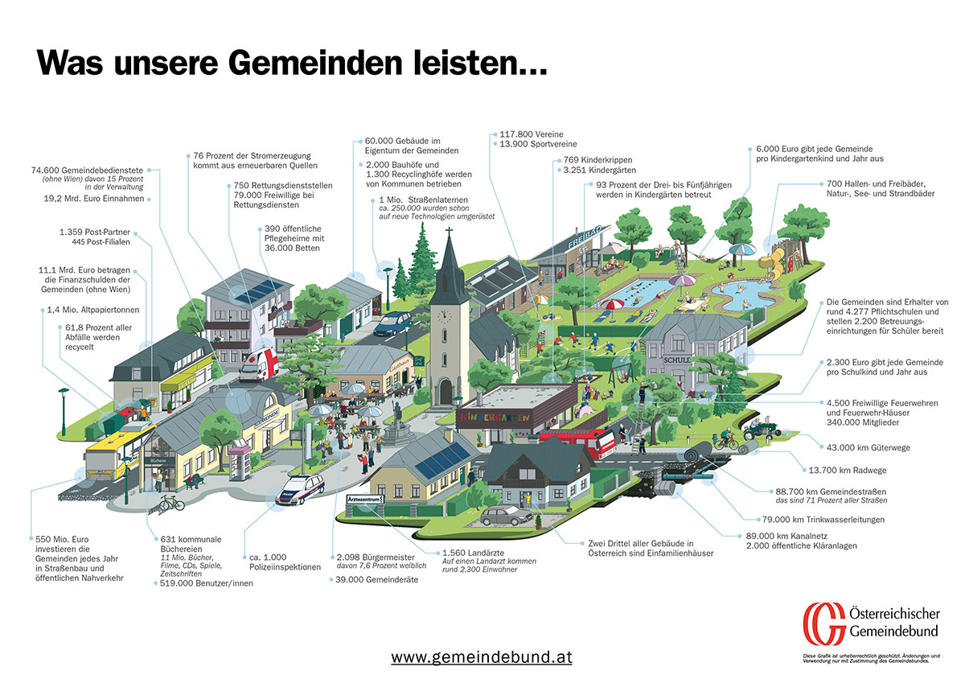
Waste Management
nature
Public green and parks
Drinking water supply
Leisure and free time infrastructure
Fire departement
Cycle Ways
schools
childrens garden
Caring old People
Street building
Public buildings
f.e. Builders Yard
Waste water management
Street lightning

Slide 7
Municipalities influence the developement and organization of….

Slide 8
Local Security
Rescue System
Volunteer System
Postal delivery system
Local Supply System
Economic production plants
Food supply
Police station System
local farming
Energy and
electricity supply
Private and economic house building
Health Care System

Slide 9
Municipialitie´s Needs….
Communities are the best place for implementation of sustainable acting

Slide 10
Cooperation tools
if a community is not able to implement a project or an infrastructure by its own, it has to do it in partnership with neighbouring communities or private partners.
There is a benefit of shared experience, roof organizations are caring for cooperation and know-how-exchange, they support and stimulate communities in their activities.
Roof top organisations need tools to make cooperation „simple“

Slide 11
Measuring and Management tools
f.e. in drinking water supply oder waste water management
Facts of drinking water supplyment in Austria
water extraction 800 Mio m³ /annum, (used by supply 660 Mio m³)
reservoir volume 4,1 Mio m³ (> ca. 400 – 700 litres per capita centrally supplied)
water mains (pipes and aquaeducts) 81.000 km
Facts of waste water management in Austria
95% of the households are connected to the public sewage system
organizational form:
  75% municipalities,
  20% communal cooperations (Verbände)
  3% communal enterprises – if the community is to small the task can be done in cooperation.
90.800 km canals (62 % sewers, 26% rain combined, 12 % rain), more than 51% (46.500 km) built after 1994
16.000 sewage plants, expanding capacity to 28 Mio population equivalent
Operational waste heat and fermentation gases are in many cases reused for energy production

Slide 12
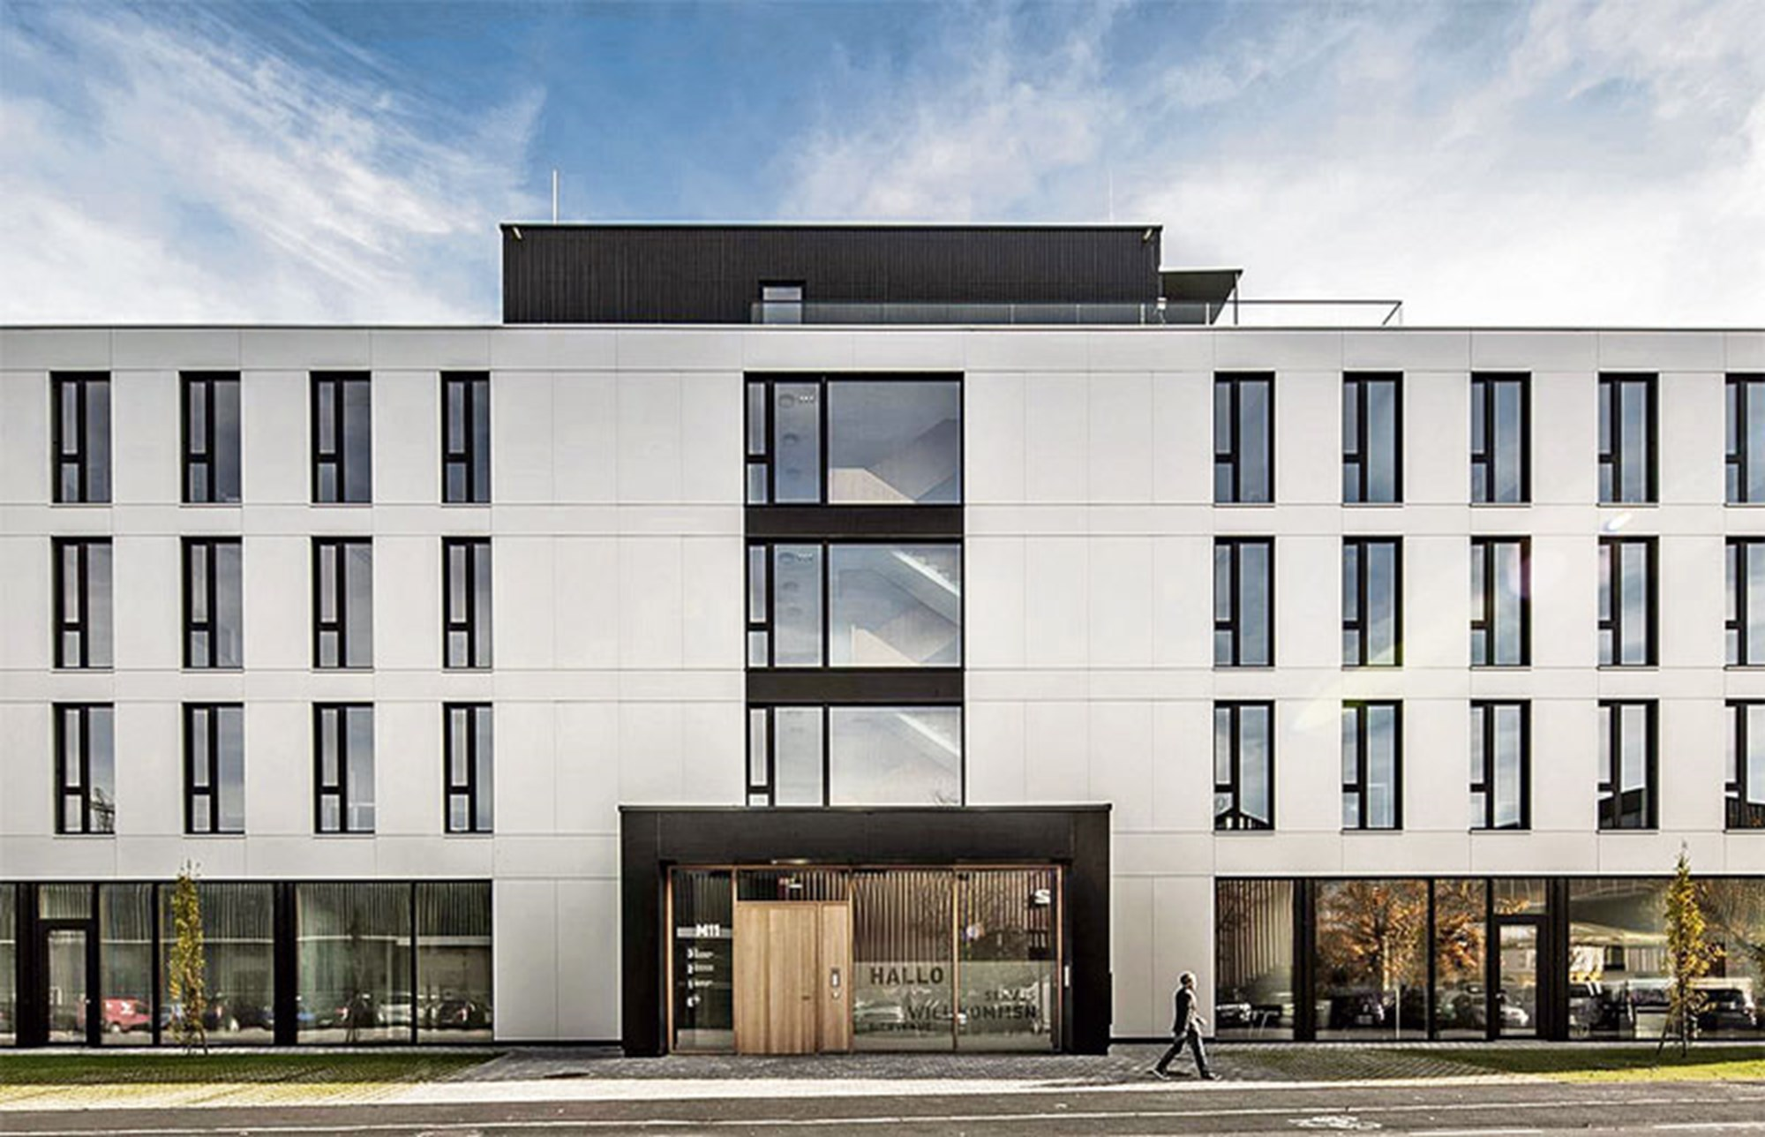
Planning tools and area/building management tools
Vacant building management
Area development management
Energy management
and so on….

Slide 13
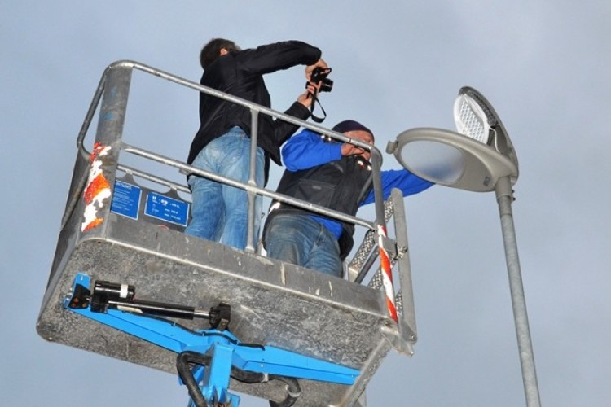
Tools for management public facilities
  Lightning
  public playgrounds
  Public roads oder ways
  Traffic management
  Sharing technologies
  ….

Slide 14
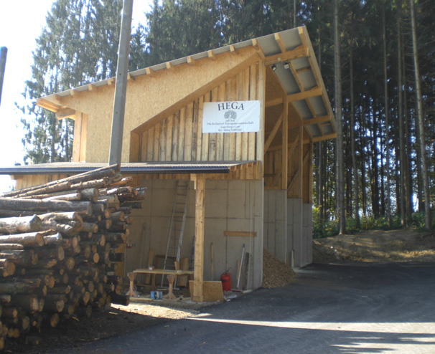
Tools for management
Energy supply/Waste Management/….
Tools to save energy and Ressources
…..

Slide 15
Please remember:
Municipalities are „homeland“ to the citizens.
Make technical solutions „human“
Communities are the best place for implementation of sustainable acting

Slide 16
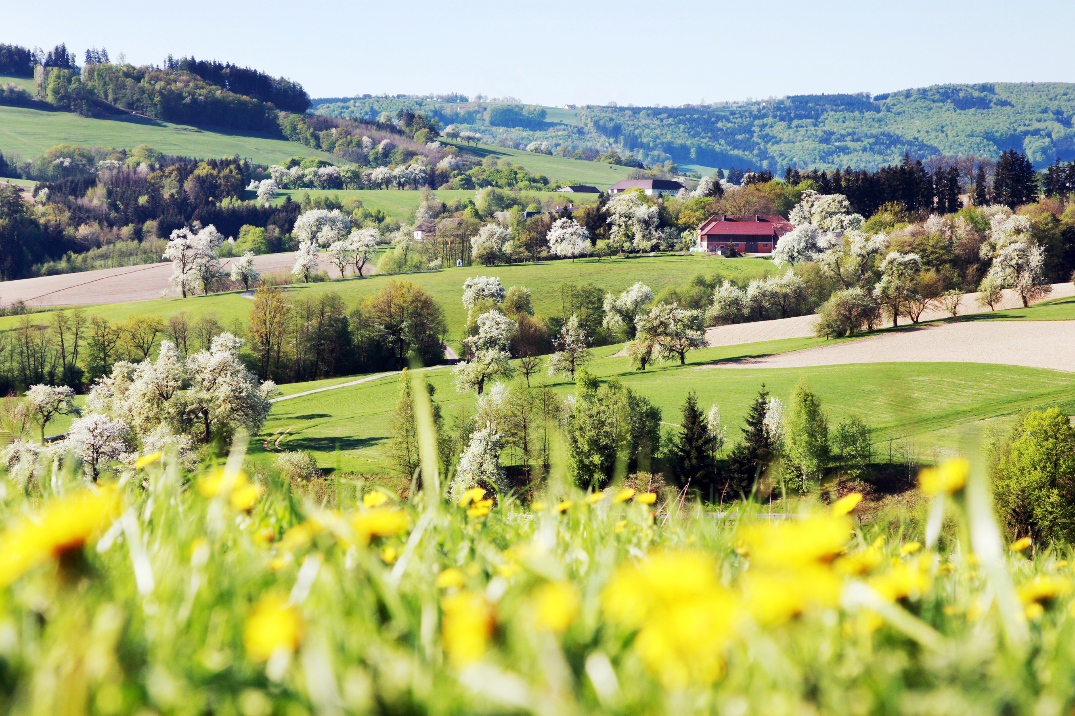
Habitat
communities give us home, they
create
secure
and shape
the common habitat on the base level

